Slide 1

Microsoft Azure Stack Hub
Azure Resource Manager Templates
This work is licensed under a Creative Commons Attribution - ShareAlike 4.0 International Public License

Slide 2
Agenda
Overview
ARM concepts
ARM API, Resource Groups, Resource Tags
Authoring ARM Templates
Template format, syntax, and parameters
Setting up your environment
Use tools such as Visual Studio and PowerShell to create and deploy templates

Slide 3
Azure Resource Manager (ARM) Concepts

Slide 4
Azure Resource Manager
Describe
Deploy
Control
App
Database
Compute
Network
Storage
A declarative, template-driven approach
Serves to orchestrate deployment across different resources
Maps configuration to resource settings
Central endpoint to:
Deploy models for cloud service resources
Manage lifetime and global properties of cloud services

Slide 5



Azure Resource Manager
Describe
Where Resource inventory
What Component relationships
How Tags + links + groups
Provision
Where Across regions
What Across resources
How In service and in guest
Control
Who Access control
What Changes
How RBAC, subscriptions, and locks

Slide 6
Azure Resource Manager
Application lifecycle container
Deploy and manage your application (or resources) as you see fit
Declarative solution for provisioning and configuration
Simplified deployment of multiple instantiations of your application via JSON templates
Consistent management Layer
Same deployment and management experience from the Portal, PowerShell, xPlat CLI, and Visual Studio
Azure Resource Manager capabilities
Centralized auditing, simple tagging, and grouping and RBAC

Slide 7
Management using Azure Resource Manager
Management and provisioning of ARM resources can be performed using:
REST API
Management Portal
PowerShell
Xplat CLI
ARM Templates
Azure CLI
Each mechanism uses the ARM API
MANGAGEMENT PORTAL
ARM TEMPLATE
POWERSHELL & XPLAT CLI
Azure Service
REST API

Slide 8
Resource providers
A resource provider is a service that supplies the resources you can deploy and manage through Resource Manager.
Example:
If you want to deploy an Azure Key Vault for storing keys and secrets, you will work with the Microsoft.KeyVault resource provider.
To deploy and manage your infrastructure, you will need to know details about the resource providers:
What resource types it offers
Version numbers of the REST API operations
Operations the resource provider supports
Schema to use when setting the values of the resource type to create

Slide 9
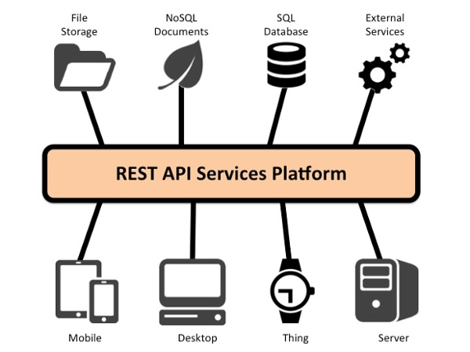
The Representational State Transfer (REST) API
ARM uses REST API to manage resources:
Linked Resources
Management Locks
Policy Assignments
Policy Definitions
Resources
Resource Groups
Resource Providers
Role-based Access Control
Subscriptions
Tags
Template Deployments
Tenants
You are responsible for making sure these requests are secure (i.e. use service principals)

Slide 10
Resource groups
Tightly coupled containers of multiple resources of similar or different types
Every resource must exist in one and only one resource group
Resource groups can span regions
RESOU
R
CE G
R
OUP
RESOU
R
CE G
R
OUP

Slide 11
Resource group lifecycle
Question:
Should these resources be placed in the same resource group or in separate ones?
Hint:
Do they share a common lifecycle and method of management?
Answer:
Up to you, or….
In Visual Studio:
For Devs → it’s an app
For DevOps → it’s an environment

Slide 12
Organizational concepts
Resource groups
Tightly coupled to a container of resources
Follows RBAC rules
1 resource group at a time
Scope for billing controls
Resource tags
Loosely coupled user or system-defined categorization
Arbitrary boundaries
15 tags to use as needed
Defined by platform and user
Resource groups and tags are the building blocks to define applications

Slide 13
Organizing with resource tags
Name-value pairs that can be assigned to resources or resource groups
Can be pre-created to assist with auto-completion for tag consistency
Used for categorization or to add custom metadata
Show resources owned by a department or cost center
E.g. tagname = “department” & tagvalue = “finance”
Management portal will show views of resources organized by tags that will include Monitoring and Billing lenses related to those resources

Slide 14
Authoring ARM Templates

Slide 15
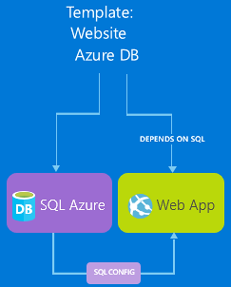
ARM templates
A declarative, model-based specification of resources and their configuration, code, and extensions
Idempotent
Consistent deployment
Source file, checked-in
Parameterized input / output

Slide 16
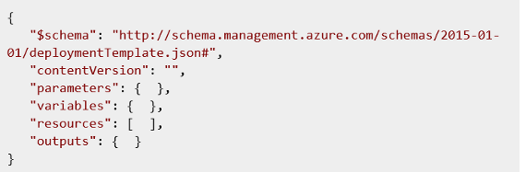
Template format Simplest structure and elements

Slide 17
Template format (continued)
Element name | Required | Description
$schema | Yes | Location of the JSON schema file that describes the version for the template language. You should use the URL
contentVersion | Yes | Version of the template. (i.e.1.0.0.0). Any value can be provided. When deploying resources using the template, this value ensures that the right template is being used
parameters | No | Values that are provided when deployment is executed to customize resource deployment
variables | No | Values that are used as JSON fragments in the template to simplify template language expressions
resources | Yes | Resource types that are deployed or updated in a resource group
outputs | No | Values that are returned after deployment

Slide 18
Basic overview
The syntax of the template is JSON.
Expressions:
Are enclosed with brackets ([ and ])
Are evaluated when the template is deployed
Can appear anywhere in a JSON string value
Always return another JSON value
Note: If you need to use a literal string that starts with a bracket [, you must use two brackets [[.

Slide 19
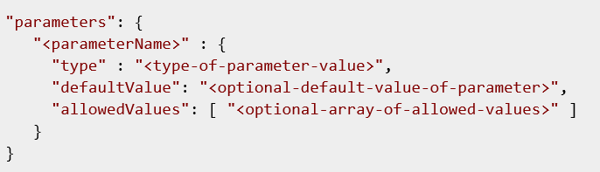
Parameters
Parameters section of the template
Specify which values you can input when deploying the resources
Enable you to customize the deployment by providing values that are tailored for a particular environment (such as dev, test, and production)
Note: Parameters are optional. However, without parameters, your template would always deploy the same resources with the same names, locations, and properties.

Slide 20
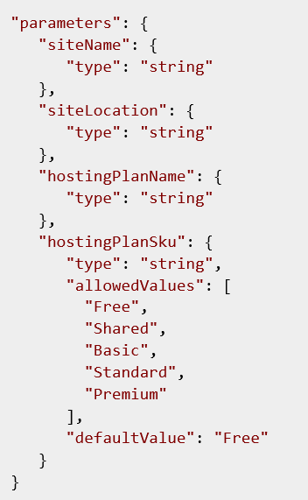
Parameters (continued)
Used throughout the template to set values for the deployed resources
Only parameters that are declared in the parameters section can be used in other sections of the template
You cannot use a parameter value to construct another parameter value within the parameters section
Construct new values in the variables section of the template

Slide 21
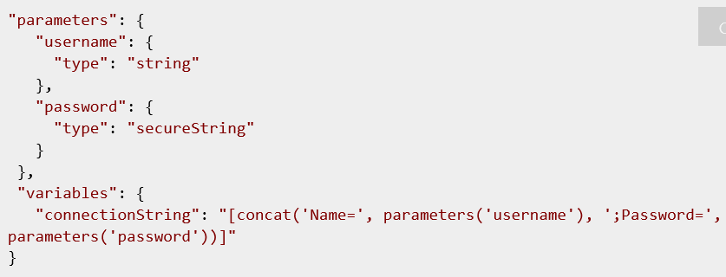
Variables
Variables section of the template
Construct values that can be used throughout your template
Typically based on values provided from the parameters
Defining variables is optional but can simplify your template by reducing complex expressions

Slide 22
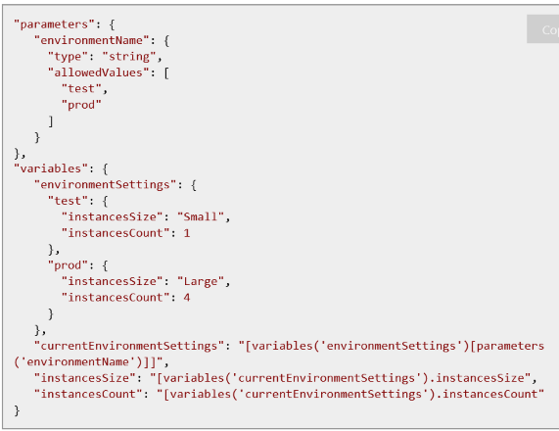
Variables (continued)
Example: Variables to create an IaaS Machine
Variables section

Slide 23
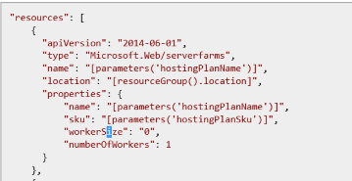
Resources
Resources section of the template
Define the resources are deployed or updated
Requires understanding of resource types to provide correct values
Size

Slide 24
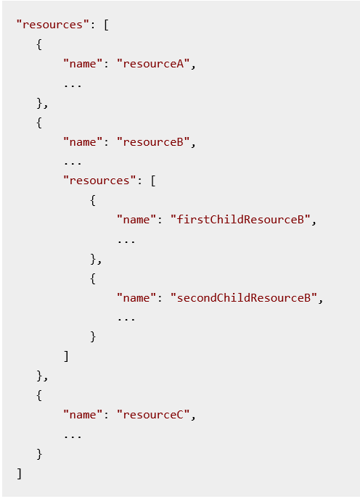
Resources (continued)
Structure
Contains an array of the resources to deploy
Can also define an array of child resources for that resources
Example of the resources property

Slide 25
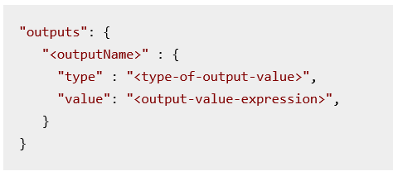
Outputs
In the outputs section, you specify values that are returned from deployment. For example, you could return the URI to access a deployed resources.
Example

Slide 26
Outputs – Example
A value returned in the outputs section
"outputs": {
"siteUri" : {
"type" : "string",
"value": "[concat('http://',reference(resourceId('Microsoft.Web/sites', parameters('siteName'))).hostNames[0])]"
}
}

Slide 27
ARM schemas
JSON files use a schema which is referenced at the top of each file.
The schema defines what elements are allowed, the types and formats of fields, the possible values of enumerated values, etc.
Three main ways to explore the schema and properties available:
Published schema files
Example / sample templates
JSON responses from the REST APIs

Slide 28
Expressions and functions
Extend the JSON available in the template
Enable you to create values that are not strict literal values
Additionally, expressions:
Are enclosed with brackets ([ and ])
Are evaluated when the template is deployed
Can appear anywhere in a JSON string value and always return another JSON value
Typically, you use expressions with functions to perform operations for configuring the deployment.
"variables": {
"location": "[resourceGroup().location]",
"usernameAndPassword": "[concat('parameters('username'), ':', parameters('password'))]",
"authorizationHeader": "[concat('Basic ', base64(variables('usernameAndPassword')))]"
}

Slide 29
Using expressions
You use expressions with functions to perform operations for configuring the deployment.
Function calls are formatted as functionName(arg1,arg2,arg3)
You reference properties by using the dot and [index] operators
The following example shows how to use several functions when constructing values:
"variables": {
"location": "[resourceGroup().location]",
"usernameAndPassword": "[concat('parameters('username'), ':', parameters('password'))]",
"authorizationHeader": "[concat('Basic ', base64(variables('usernameAndPassword')))]"
}

Slide 30
Linking ARM Templates
From within one Azure Resource Manager Template, you can link to another template which enables you to decompose your deployment into a set of targeted, purpose-specific templates.
Link to a parameter file
You can pass parameters from a main template to a linked template, and those parameters can directly map to parameters or variables exposed by the calling template.
Use variables to link templates together
The linked template can also pass an output variable back to the source template, enabling a two-way data exchange between templates.
To document and provide query capability over the relationships between resources, you should instead use resource linking.

Slide 31
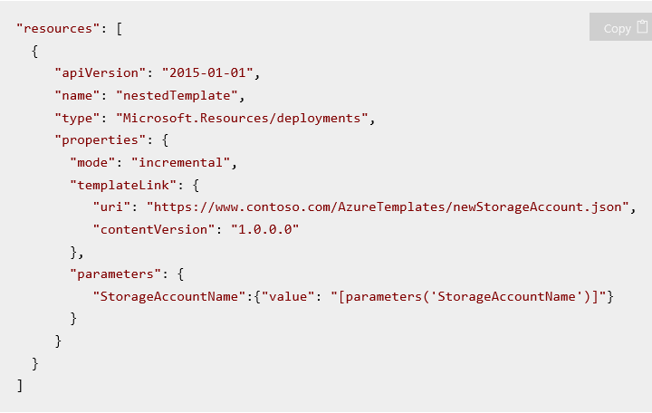
Linking to a template
Create a link between two templates:
Add a deployment resource within the main template that points to the linked template
Set the templateLink property to the URI of the linked template
(Optional) Provide parameter values for the linked template either by specifying the values directly in your template or by linking to a parameter file
This example uses the parameters property to specify a parameter value directly.

Slide 32
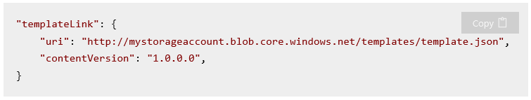
Linking to a template
Requirements:
The Resource Manager service cannot access a local file or a file that is only available on your local network for the linked template
You can only provide a URI value that includes either http or https

Slide 33
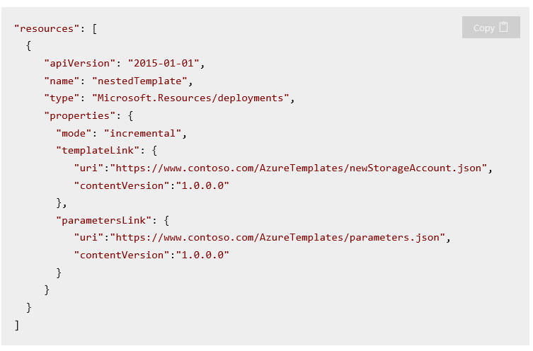
Linking to a parameter file
The next example uses the parametersLink property to link to a parameter file
The URI value for the linked parameter file cannot be a local file, and must include either http or https

Slide 34
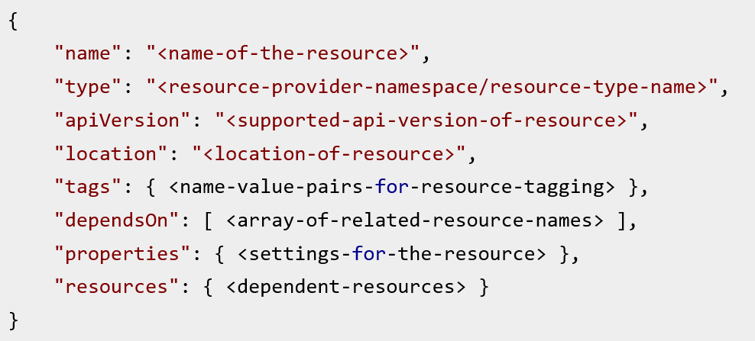
Defining dependencies in ARM Templates
ARM templates allow you to define dependencies between resources:
dependsOn property
resources property
The dependencies between resources are evaluated and resources are deployed in their dependent order.

Slide 35
Property – dependsOn
Why use this property?
Provides ability to define dependencies for a resource
Dependence on having a database resource successfully provisioned for a given VM
Dependence for multiple nodes in your cluster to be installed before deploying a VM with the cluster management tool
Evaluates dependences between resources so resources are deployed in their dependent order
Not applicable use cases
Documenting how resources are interconnected,
Risking negative performance impact where you may inadvertently distract the deployment engine from using parallelism where it might have otherwise

Slide 36
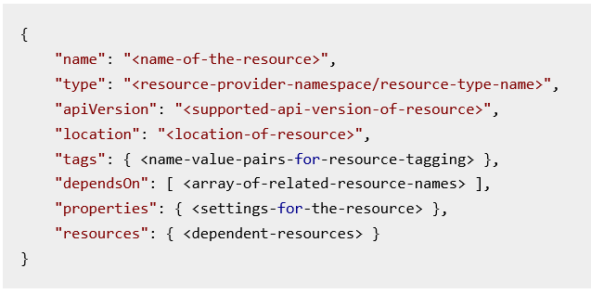
Property resources
The resources property allows you to specify child resources that are related to the resource being defined. Child resources can only be defined 5 levels deep.
Note: If you need the child resource to be deployed after the parent resource, you must explicitly state that dependency with the dependsOn property.
Additional conditions:
Each parent resource accepts only certain resource types as child resources
Accepted resource types are specified in the template schema of the parent resource
The name of child resource type includes the name of the parent resource type, such as Microsoft.Web/sites/config and Microsoft.Web/sites/extensions are both child resources of the Microsoft.Web/sites

Slide 37
Setup your ARM Template Authoring Environment

Slide 38
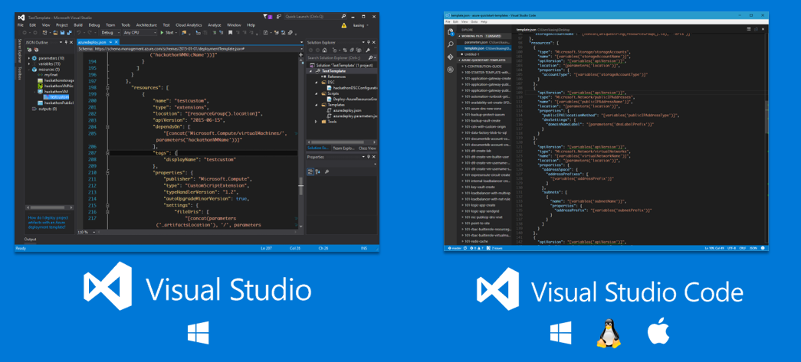
Available development environments
… or any Text Editor.

Slide 39
Resource Manager: PowerShell

Slide 40
Deploy the template
Example: Use the New-AzureRmResourceGroupDeployment cmdlet
New-AzureRmResourceGroupDeployment `
-ResourceGroupName TestRG1 `
-TemplateFile c:\Azure\Templates\azuredeploy.json
Notes:
Specify the resource group and the location of the template
Use the -TemplateUri parameter to specify a non-local URI for the template
Set the -Mode parameter to either Incremental or Complete. By default, this parameter is set to incremental

Slide 41
Dynamic template parameters
Navigating the template
Cycle through the available parameters for a cmdlet by typing a minus sign (-) and then pressing the TAB key
As soon as you type the template name, the cmdlet fetches the template, parses it, and adds the template parameters to the command dynamically
If you forget a required parameter value, PowerShell prompts you for the value
New-AzureRmResourceGroupDeployment `
-ResourceGroupName TestRG1 `
-TemplateFile c:\Azure\Templates\azuredeploy.json `
-hostingPlanName freeplanwest `
-serverName exampleserver `
-databaseName exampledata `
-administratorLogin exampleadmin

Slide 42
Deploy the template
Parameter: What to watch out for
If the template includes a parameter with a name that matches one of the parameters in the command to deploy the template (such as including a parameter named ResourceGroupName in your template which is the same as the ResourceGroupName parameter in the New-AzureRmResourceGroupDeployment cmdlet), you will be prompted to provide a value for a parameter with the postfix FromTemplate (such as ResourceGroupNameFromTemplate)
In general, you should avoid this confusion by not naming parameters with the same name as parameters used for deployment operations

Slide 43
Deploy the template
The command runs and returns messages as the resources are created. Ultimately, you see the result of your deployment.
DeploymentName : azuredeploy
ResourceGroupName : TestRG1
ProvisioningState : Succeeded
Timestamp : 10/16/2015 12:55:50 AM
Mode : Incremental
TemplateLink :
Parameters :
Name Type Value
=============== ========================= ==========
hostingPlanName String freeplanwest
serverName String exampleserver
databaseName String exampledata
administratorLogin String exampleadmin
administratorLoginPassword SecureString
Outputs :

Slide 44
ARM Template troubleshooting

Slide 45
Debugging overview
Template validation
Use tool with JSON validation (Examples: Visual Studio, Atom w/ JSONLint, or others )
Leverage Test-AzureResourceGroupTemplate cmdlet
Resource group logging
Portal: Browse → Resource Groups → <Group> → Events
PowerShell: Get-AzureResourceGroupLog
Azure CLI: Azure group log show
Azure Rest API Explorer
View individual resources as they are deployed: https://resources.azure.com

Slide 46
Debugging the template…
What I do…
Error Messages & Deployment Output
Test expressions in deployment outputs
Activity Logs (portal)
--debug switch
PowerShell / CLI will show the entire REST conversation
VM Extension Logs - Custom Script Extension
https://docs.microsoft.com/en-us/azure/virtual-machines/extensions/custom-script-linux#troubleshooting
/var/lib/waagent/custom-script/download - contains the downloaded files and the stdout log
/var/log/azure/custom-script - handler.log
/var/lib/waagent/Microsoft.Azure.Extensions.CustomScript-2.0.6/config/ - 0.settings file - for uri's of downloads
StackOverflow / MSDN / Docs

Slide 47
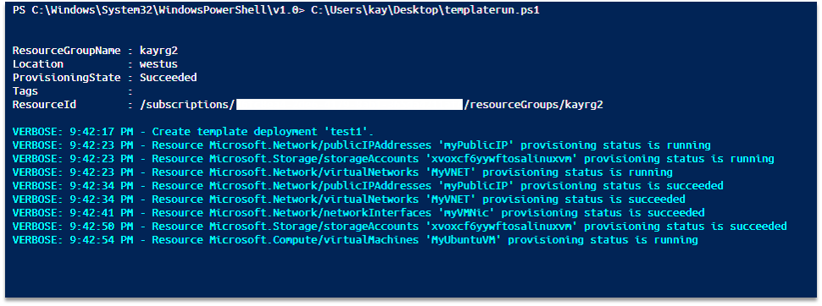
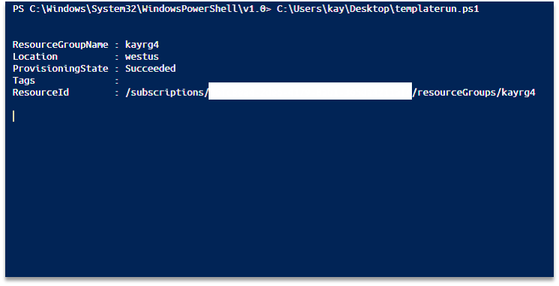
-Verbose
New-AzureRmResourceGroupDeployment -Name test1 -ResourceGroupName $resourceGroupName -TemplateFile $templateFile -TemplateParameterFile $templatePrameterFile -Verbose

Slide 48
Common template errors
Globally unique names / naming collisions
Some resource names are globally unique, some are not
Regex / casing problems in names
Globally unique names (e.g. dns) must conform to a regex (lower case, numbers, dashes)
Storage account provisioning delay
Deleted storage accounts cannot be recreated for 10 mins or so
Case sensitive URIs
Parameters values that refer to URIs are case sensitive (dsc.zip vs. DSC.zip)
JSON syntax (quotes, brackets, parens)
Test-AzureResourceGroupTemplate or deployment validation
DSC Errors
Debugging DSC via local logs (c:\WindowsAzure on the VM)
Location/Region conflicts
Resource Group exist in another location (command line deployments)
Locations and RP availability (this is becoming more and more rare)
Switch-AzureMode, then Get-AzureLocation
Incremental deployments
Artifacts location empty / null

Slide 49
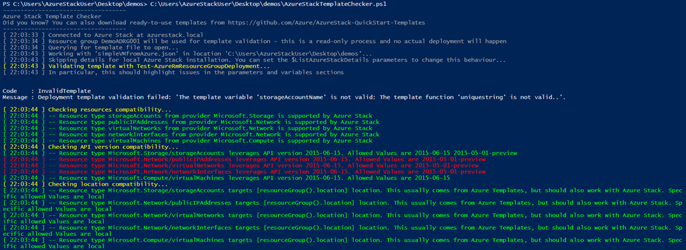
Azure Stack Hub Template Validator
Tool to verify a working template for compatible resource types, API versions, URIs, etc.
https://github.com/Azure/AzureStack-Tools/tree/master/TemplateValidator
$TemplatePath = "<Provide Template(s) Path>"
$CapabilitiesPath = ".\AzureStackCapabilities_TP2.json"
Test-AzureRMTemplate -TemplatePath $TemplatePath -CapabilitiesPath $CapabilitiesPath -Verbose #-IncludeComputeCapabilities

Slide 50
Questions?

